Slide 1
IBM Bluemix DevOps服务
加速应用开发
万郁香, DevOps 解决方案架构师
wanyux@cn.ibm.com

Slide 2
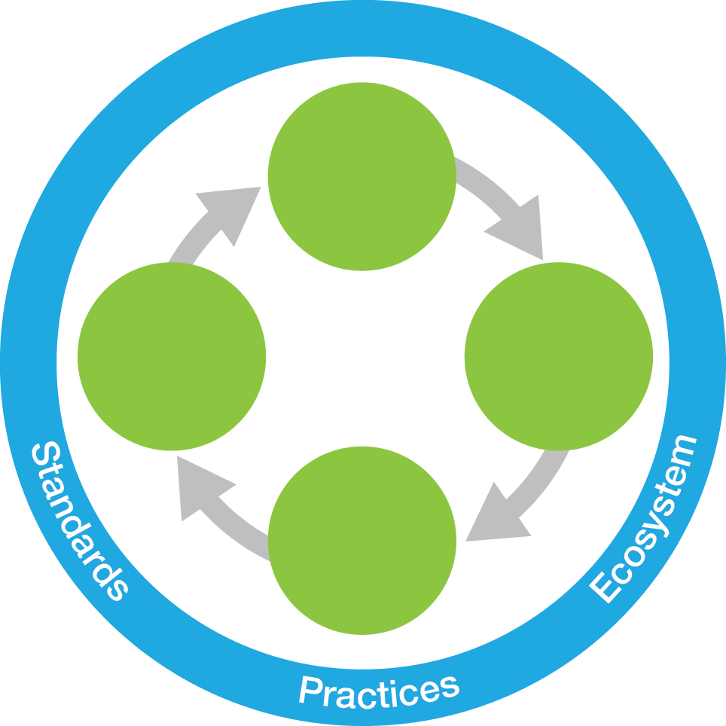
IBM的DevOps观点 一种软件持续交付企业级能力，使组织能够快速捕获市场机会，缩短客户反馈时间
持续的业务规划
加速软件交付–
从速度到价值
持续的用户反馈和优化
协作开发
掌控
平衡速度，成本，质量和风险–
从能力增长到创新
精益
敏捷
运维
开发/ 测试
持续监控
部署
持续测试
缩短客户反馈时间–
改进的客户体验
持续部署和发版
IBM的DevOps观点与客户产生共鸣，他们正在用DevOps创造可度量的商业成果
Notes:
2
Main point: DevOps is an enterprise capability for continuous software delivery that enables clients to seize market opportunities and reduce time to customer feedback
----------------------------------------------------------------------------------------------------------------------------------------------------------------------------------
Here is the IBM definition of DevOps. It enables clients to:
Accelerate software delivery - by enabling collaboration between customers and enterprises and eliminating organizational silos
Balance speed, cost, quality and risk- By automating manual processes and eliminating waste
Improve client experience - By speeding the customer feedback loop
Notes:
-----------------------------------------------------------------------------------------------------------------------------------------------------------------------------------------
“Companies that master effective software development and delivery in rapidly changing environments such as cloud, mobile and social will have a significant competitive advantage,” - Kristof Kloeckner, general manager, IBM Rational Software.
2

Slide 3
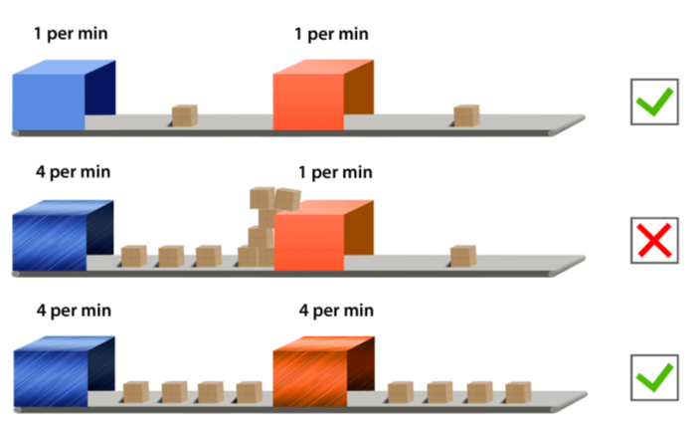
优化的匀速流水线
各个流程的生产能力必须相同，以避免堆积和瓶颈
当前序流程生产能力升级时，后继流程的生产能力也必须提升到相应的水平，以维持平衡
Notes:
For Continuous flow of changes through the delivery pipeline, it is important to ensure that throughput of each process (Develop, Build, Deploy) is equal. Improving the efficiency of the preceding processes, without improving subsequent processes creates an imbalance, and reduced efficiency of delivery. This is what Agile Development had done, where Dev changes were piling up at Test and Release stages. We fixed it with IBM UrbanCode Deploy and IBM UrbanCode Release.

Slide 4

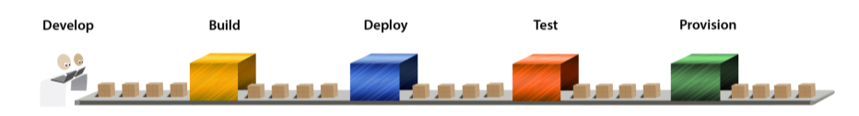




IBM DevOps提高应用交付速率
Release
Rational Team Concert
Rational Focal Point
Rational Requirements Composer
Rational Build Forge
IBM UrbanCode Deploy
IBM UrbanCode Release
Rational CLM支撑协同开发
Rational Test Workbench和Rational Test Virtualization Server (GreenHat) 支撑持续测试
IBM UrbanCode解决方案支撑持续发布和部署
SmartCloud Monitoring, Worklight Quality Assurance, IBM Digital Analytics以及其他工具支撑持续监控和持续反馈
Notes:
IBM has offerings to support each of the practices required for Continuous Delivery pipeline that involves Develop, Build, Deploy, Test and Release. Rational CLM offerings enable Agile Development to support Collaborative Development. Rational Build Forge enables the output of Agile Development with Continuous Integration. IBM UrbanCode solutions enable Application Release Automation and support the practice of Continuous Release and Deploy. Finally, Rational Test Workbench and Rational Test virtualization enable Continuous Testing. There is also SmartCloud APM and TeaLeaf for Continuous Monitoring and Feedback.
With these DevOps offerings, customers can create a continuous flow of changes through the delivery pipeline thereby increasing the speed of delivery.

Slide 5



DevOps和云的采用 使用DevOps和云的快速自动化交付
Traditional On-Premises
Infrastructure
as a Service
Platform
as a Service
Applications
Applications
IBM DevOps Services
Applications
Data
UrbanCode Deploy
(available with UCDP)
Data
Data
UrbanCode Deploy
Mid Config
Mid Config
Mid Config
Middleware
UrbanCode Deploy w/Patterns
Middleware
Middleware
IBM Patterns
O/S
O/S
O/S
Manual
(provisioning & deployment only)
PureApplication System
SmartCloud Orchestrator
SoftLayer
IBM Bluemix
Virtualization
Virtualization
Virtualization
Servers
Servers
Servers
Storage
Storage
Storage
Networking
Networking
Networking
定制化，高成本，低效
标准化，低成本，高效

Slide 6





云上的持续部署 更快，可重复，高可靠
云环境配置
IBM UrbanCode Deploy
with Patterns
SCM
构建自动化
获取变更
推送构建
部署自动化
IBM PureApplication System
IBM UrbanCode Deploy
SmartCloud Orchestrator
执行应用部署，管理跨环境配置
DEV
QA
PROD
DEV
DEV
DEV
云环境
版本化的应用执行包
版本化的环境配置
https://ibm.biz/BdFcmV
Notes:
Automate provisioning of environments as part of the end-to-end delivery process – Establish and automate deployment of Application Blueprint with resource templates imported from Cloud patterns.
Deploy early and often to ensure high quality and faster releases using repeatable, reliable, and managed automation - Seamless process flow for incremental, full stack provisioning and application deployment automation

Slide 7

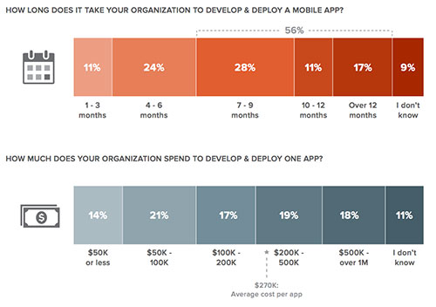
软件应用的革新
根本性的改变了我们与技术交互的方式
Apps are everywhere
The quantity and usefulness of web and mobile apps has led to an “app revolution” among consumers and businesses alike.
Experience matters
Customers and employees now expect a delightful and seamless experience across all interactions with a business.
Cloud makes it possible
Apps today can be stitched together quickly with pre-built assets. Cloud makes the API economy possible.
Bad mobile app experiences by consumers:
50
percent
65
percent
of consumers would uninstall
your app - immediately
of consumers would not purchase products from your company
50% of CIOs think Mobile app. development takes too long
“IBM Mobile App Consumer and Enterprise Survey”, a commissioned study conducted by Forrester Consulting on behalf of IBM, September, 2014
http://www.propelics.com/fifty-percent-cios-think-mobile-app-development-takes-long/
Notes:
Apps Are Everywhere
Over the last 5 or so years, we’ve experienced an “App Revolution” on the web, on our smartphones, in our cars, on wearable devices (like a NikeFuel band, Smart Watch, Google Glass), and in our homes.
Apps today allow interactions that we wouldn't have imagined 5 years ago. Architects can design homes on their iPads, merchants can swipe credit cards and accept payments anywhere with their phones, and runners can track their progress with a band on their wrist. Even my mother knows the phrase “there’s an app for that.”
Experience Matters
All of the associated data (like a runner’s average speed and location over the course of a 30 minute run) is often times pushed up to the cloud (as it’s being generated) for further processing, storage, or to allow syncs other devices and services.
Customers expect an integrated experience on the web, across all of their devices, in physical stores, and even talking with customer service on the phone.
Cloud Makes it Possible
Needless to say, the cloud has been a very large driving factor in the “App Revolution.” It provides a fast, simple, and cost effective way to for startups and enterprises alike to deploy and host applications and mobile backends over the internet.
Apps can be stitched together quickly with pre-built assets exposed as APIs - cloud has made this possible.
Simply put, cloud keeps all of us connected.

Slide 8




质量和时间是关键 开发移动或云端应用的敏捷团队
Who are they?
Building stuff for…
Do it fast!
New programming
models
mobile
cloud
Objective C (xCode)
Node.js
Python
GO
-------------
J2EE
PHP
(…)
predominantly
3-20
APPS
SPEED
Individuals per team
to
market
with
skill levels
These teams tend to build mobile and cloud applications using new programming models (e.g. Objective C/Java in mobile, node.js, Python, Go, scala) but also use J2EE, PHP, etc.
NEW
INT
EXP

Slide 9













Bluemix 提供在云端快速开发部署应用的高度集成平台
Bluemix 是一个基于开放标准的云平台，用于构建，管理和运行所有类型的应用（包括Web，移动，大数据，新智能设备等应用）
Go Live in Seconds
The developer can choose any language runtime or bring their own. Zero to production in one command.
APIs and Services
A catalog of IBM, third party, and open source API services allow the developer to stitch an application together in minutes.
On-Prem Integration
Build hybrid environments. Connect to on-premise assets plus other public and private clouds.
Layered Security
IBM secures the platform and infrastructure and provides you with the tools to secure your apps.
DevOps
Development, monitoring, deployment, and logging tools allow the developer to run the entire application.
Flexible Pricing
Sign up in minutes. Pay as you go and subscription models offer choice and flexibility.
Notes:
Key themes
Speed
Instant environments
Quick deployments
Sign up in minutes
Ease of Use
Instant Environments
Services prebuilt for your use - IBM, Third Party, Community
DevOps tools to monitor, plan, deploy, and manage your apps
Flexibility
On-Prem integration
Flexible pricing
Security
IBM secures the platform and infrastructure - leveraging experience with softlayer and proven on-prem security implementations
Provides you with the tools to secure your apps

Slide 10













统一的DevOps体验
Carlos/Raj
DevOps体验是统一的，开放的，跨平台技术的，而Bluemix提供DevOps的方法和集成的系统。
8
Get instantaneous feedback
from mobile apps
1
Collaborate with your team. Agile development tracking and reporting
Agile Planning
Mobile Quality
Plan & Measure
2
Use your favorite tool or web IDE
Web IDE
Sublime
Eclipse
7
Manage and monitor your apps’ performance
DevOps
Services
3
Use the repo that works best for you
Monitor & Optimize
Develop & Test
Monitoring
& Analytics
Auto-Scaling
Hosted GIT
Jazz SCM
GitHub
6
Continuously deliver across multiple environments
Release & Deploy
4
Continuously integrate code
Continuous
Integration
Jenkins
Automated
Deployment
5
Scan your apps for vulnerabilities
AppScan

Slide 11
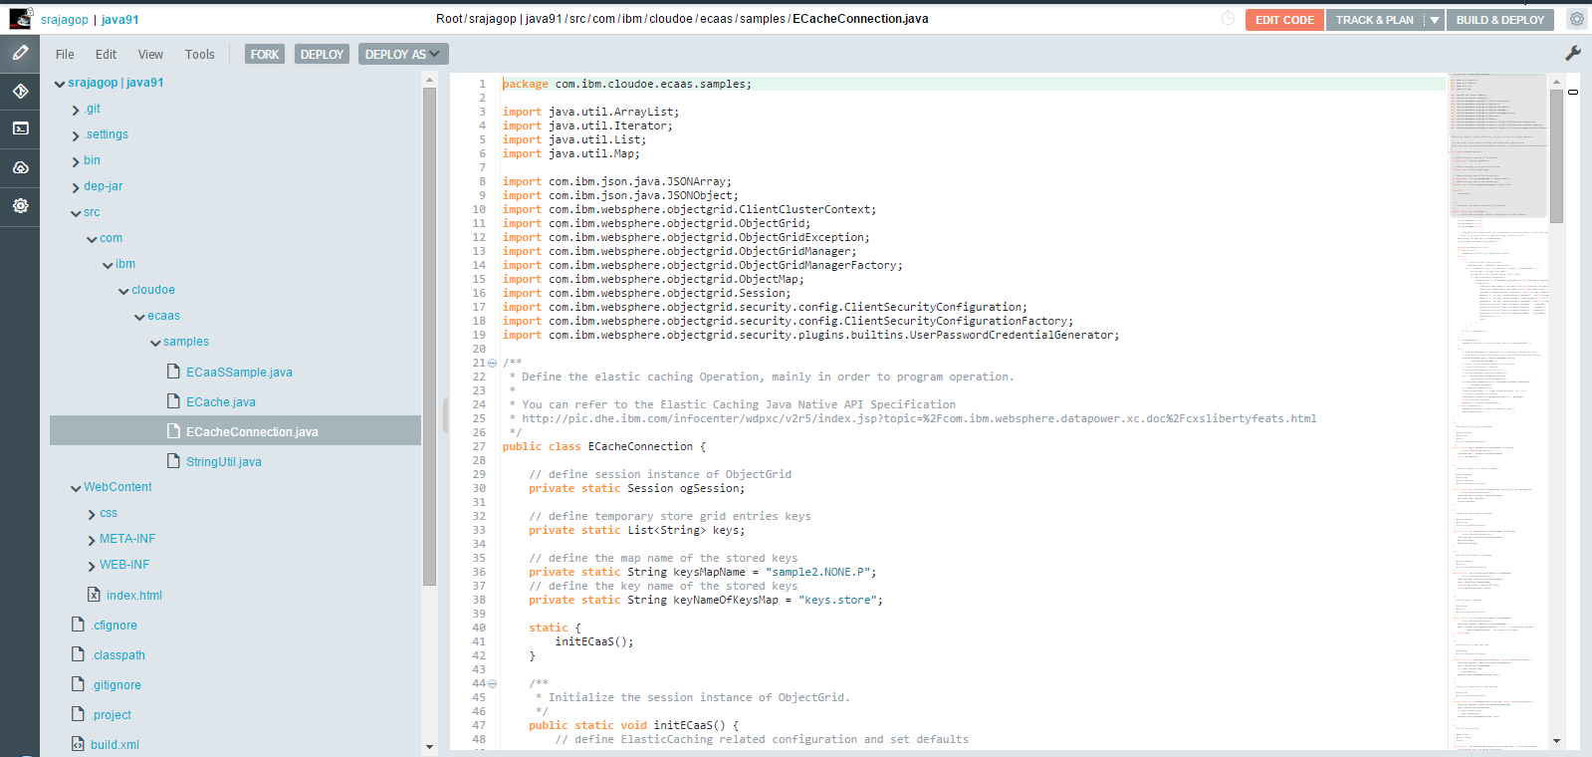

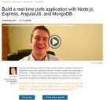
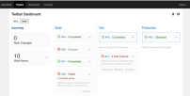
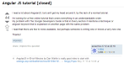
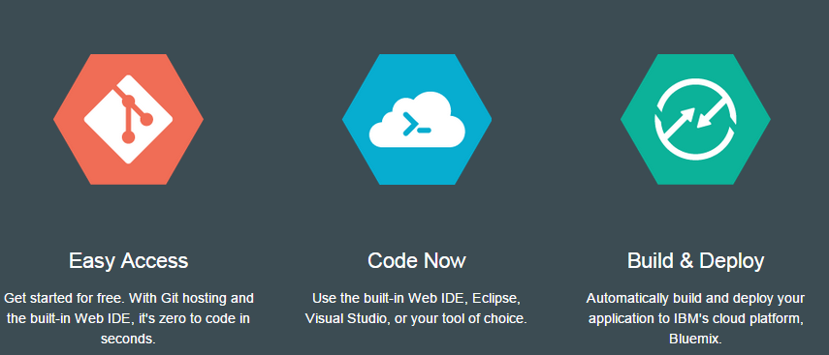
上手简单：Bluemix DevOps 为开发者提供编码“乐园”
Search to code. Go from idea to production in minutes
Google search
Relevant Content
“How-to” articles
Sample apps
Author interaction
DevOps Coding Playground
Bluemix™ DevOps Services
StackOverflow
2 Minutes
Search - Learn - Code & Deploy
Coding Playground
Searchable, relevant and rich articles, sample apps and tutorials
Preconfigured, end-to-end “coding playground”
Git Hosting, Web IDE & Team Collaboration

Slide 12
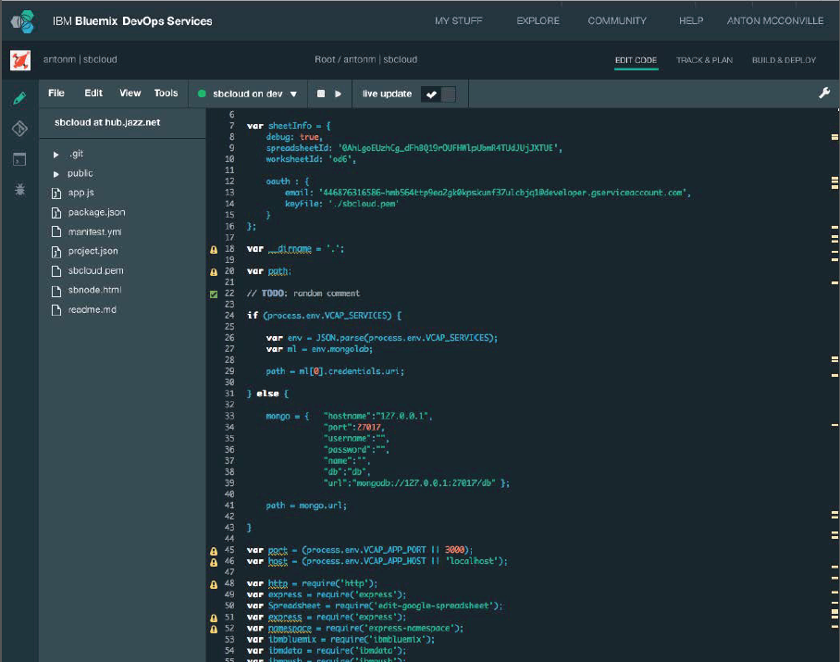
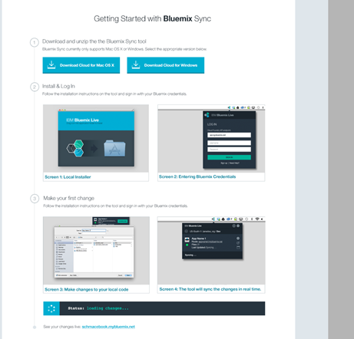
上手简单：Bluemix让开发者选择自己的编码方式
in their Cloud workspace, or locally on their desktop
In their cloud workspace using the Web IDE no need to install anything on their desktop
On their desktop using their favorite coding tools Bluemix Live Sync automatically synchronizes their changes with their cloud workspace

Slide 13
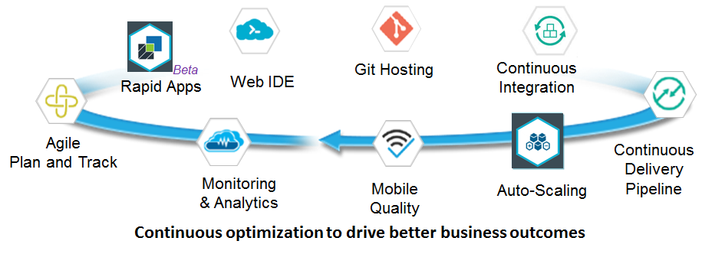
Bluemix™ DevOps为敏捷团队推荐DevOps最佳实践来加速云端的软件交付
1. Minimum Viable Product
2. Dedicated Teams
3. Loosely Coupled Architecture
4. Minimizing Hand-offs, Maximizing Flow
5. Deliver in Small Batches
6. Transparency
7. Eliminate Overhead
8. Automate Testing using APIs

Slide 14
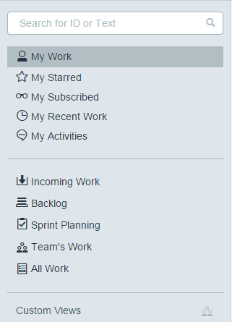
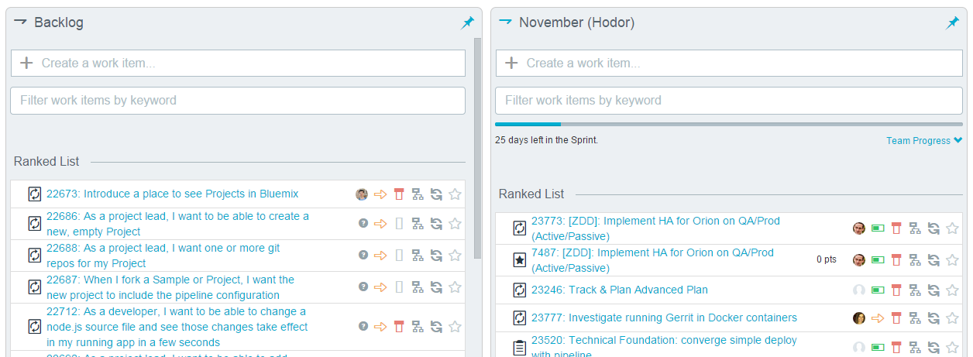
团队协作 - 敏捷规划和跟踪
1. Minimum Viable Product
2. Dedicated Teams
3. Loosely Coupled Architecture
4. Minimizing Hand-offs, Maximizing Flow
Quick Planner for Agile Teams to plan, track and manage backlogs and deliverables focused on individual and team productivity
5. Deliver in Small Batches
6. Transparency
7. Eliminate Overhead
8. Automate Testing using APIs
Action views for Individuals and Teams
Effective Sprint Planning & Backlog management

Slide 15
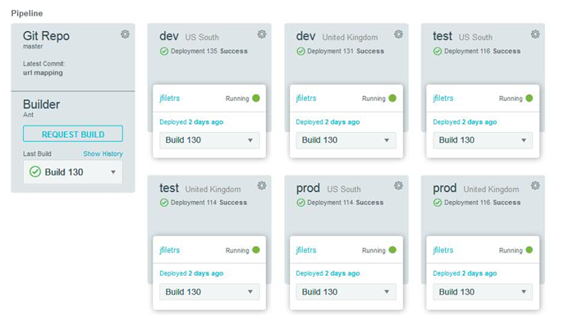
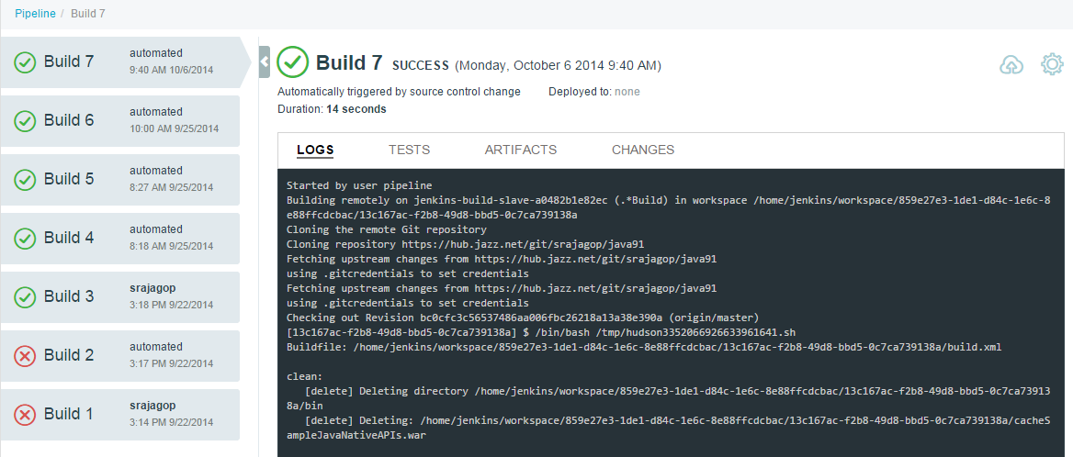
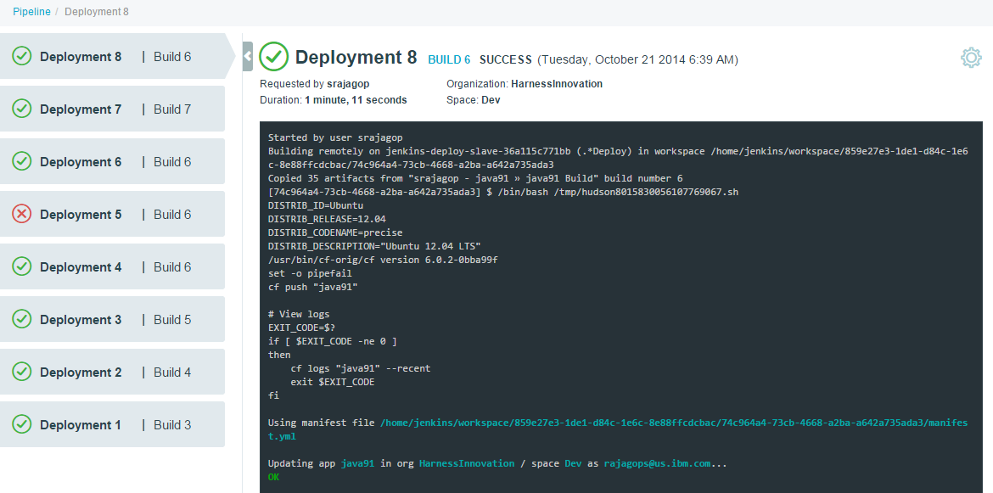
持续交付管道
Seamless and Automated Continuous Integration & Continuous Delivery across Public Cloud Regions (US, UK etc..) to ensure high quality of software delivery with speed
1. Minimum Viable Product
2. Dedicated Teams
3. Loosely Coupled Architecture
4. Minimizing Hand-offs, Maximizing Flow
5. Deliver in Small Batches
6. Transparency
7. Eliminate Overhead
8. Automate Testing using APIs
Automated Multi-stage Deployment
Continuous Integration Builds & Build History
Continuous Delivery & Deployment History

Slide 16
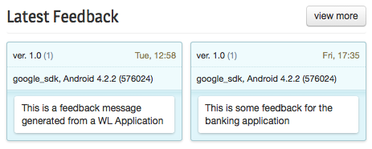
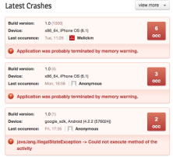
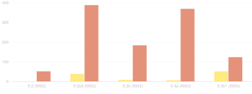
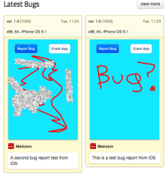



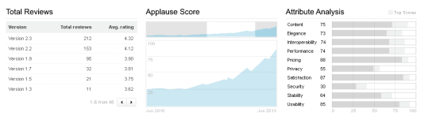
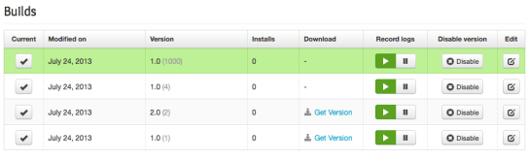
1. Minimum Viable Product
2. Dedicated Teams
3. Loosely Coupled Architecture
4. Minimizing Hand-offs, Maximizing Flow
Mobile Quality Assurance
Integrated feedback from test execution and real-world usage so you can quickly figure out if your aim is true to your customers needs
User Feedback
5. Deliver in Small Batches
6. Transparency
7. Eliminate Overhead
8. Automate Testing using APIs
Crash logs
4
Crash log reporting
Bugs vs. Crashes
Bugs
LOB/Digital Marketer
Developer
Tester
End Users
5
Sentiment Analysis
1
Over the air build distribution
2
In app bug reporting
3
In app user feedback
Quality Dashboard
with Sentiment Analysis
Builds
Notes:
So, with those pain points in mind, our initial tech preview will focus on five key use cases…
For the DEVELOPER: Over-the-Air Build Distribution – Developers can distribute new builds over-the-air to real devices for testing purposes; automatically ensures that testers have the latest build
For the TESTER: In-App Bug Reporting – Bug reports can be submitted directly from the app; available for pre- and post-launch; importantly, this also saves the contextual information around the bug, packaging up what is needed (like crash logs) to make it easy to get them to the developer
For the END USERS: In-App User Feedback – User feedback can be submitted directly from the app, enabling developers to easily spot trends, discover issues and receive new ideas from end users; also
…Crash Reporting – Automated, real-time crash reports are filtered by OS version, device and other parameters; available for pre- and post-launch
For the LOB / Digital Marketer: Sentiment Analysis, providing these users with details from the app stores on user feedback for their impressions or “sentiment” regarding mobile applications; this is based on crawling through every rating and review and then boiling it down to a single score as a means to measure user satisfaction… this will allow clients to monitor and measure how their mobile apps are performing in the eyes of users.
16

Slide 17
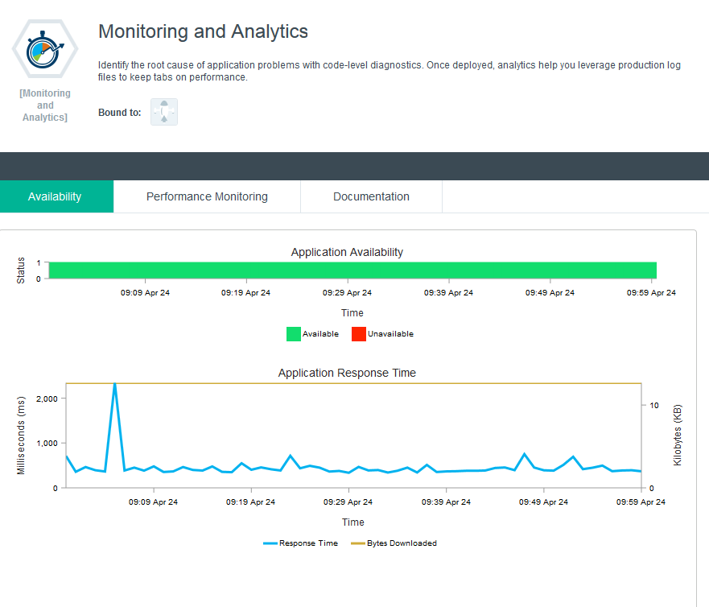
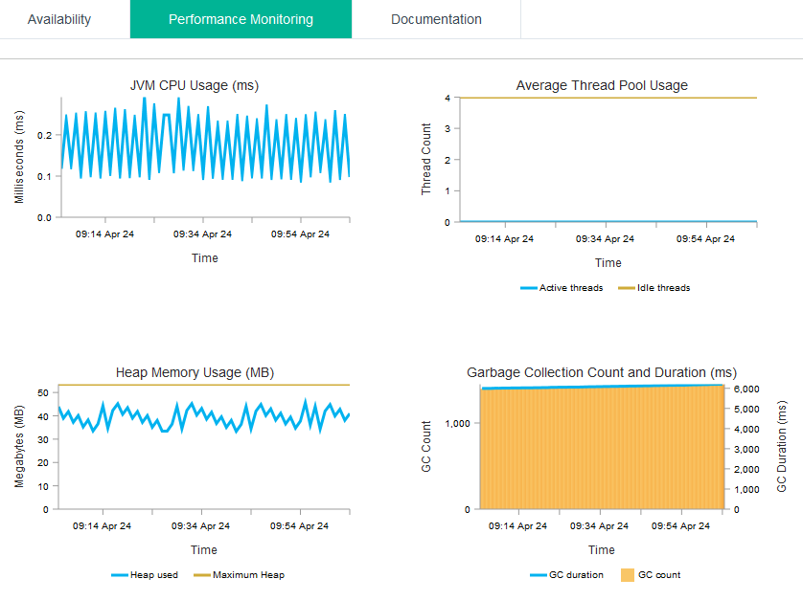
实时应用监控
1. Minimum Viable Product
2. Dedicated Teams
3. Loosely Coupled Architecture
4. Minimizing Hand-offs, Maximizing Flow
Integrated diagnostics for detailed application behavior to ensure rapid response to problems in production.
5. Deliver in Small Batches
6. Transparency
7. Eliminate Overhead
8. Automate Testing using APIs
Notes:
Gain the visibility and control you need over your applications.
Understand how your apps are performing in real time with these key metrics
Uptime
Usage
Response time
Easy-to-use dashboards and integrated analytics-powered search capability help you find the root cause line of code quickly and easily.
Integrated log file analysis on a single tab that helps you to quickly identify errors.

Slide 18


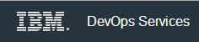


客户用Bluemix™ DevOps快速高质量地在云上交付软件
Reduced typical 6-month development effort to 15 days, from concept to running system. – Bay Area Rapid Transit & Synchrony Systems
Reduced end-to-end development time from 6 weeks to 2 weeks; accelerated standing up an operational hardware and software stack to just 30 minutes.
Sped from concept to prototype in 1 week, in-market in 3 months
Bluemix DevOps is a developer’s delight:
“We can easily modify the files and use the auto deployment to deploy using DevOps and Bluemix™, hence I will recommend this to other fellow developers” – a Top Coder Developer
18
Notes:
18

Slide 19


Slide 20
Executive Summary
The App revolution:
Organizations are being driven to deliver apps as fast as they can [to disrupt market, to differentiate with competition, etc…]. Speed is critical, still getting the app to customers is fraught with roadblocks [quality issues, funding, prioritization decisions, manual work, etc...]
The cloud has provided the platform to alleviate many of the inhibitors that once existed [wait time for servers ... provisioning ... cost], but that just leads to new bottlenecks
IBM Bluemix and IBM Bluemix DevOps help teams plow through the next set of inhibitors to create great apps and great experiences at the pace customers demand, and in a way where you can start small and scale
Built on the IBM Bluemix platform to architect your next-gen systems for elasticity and scale
Easy on boarding of team members so configuring the environment is an afterthought
Integrated feedback from test execution and real-world usage so you can quickly figure out if your aim is true to your customers needs
Leveraging these capabilities you can:
Focus on your MVP ... not your mistakes [MVP, eliminate overhead, maximize flow]
Optimize your architecture for small batch delivery [loosely coupled, small batches]
Associate your changes to the results quickly with built in analytics [transparency, automated feedback]

Slide 21
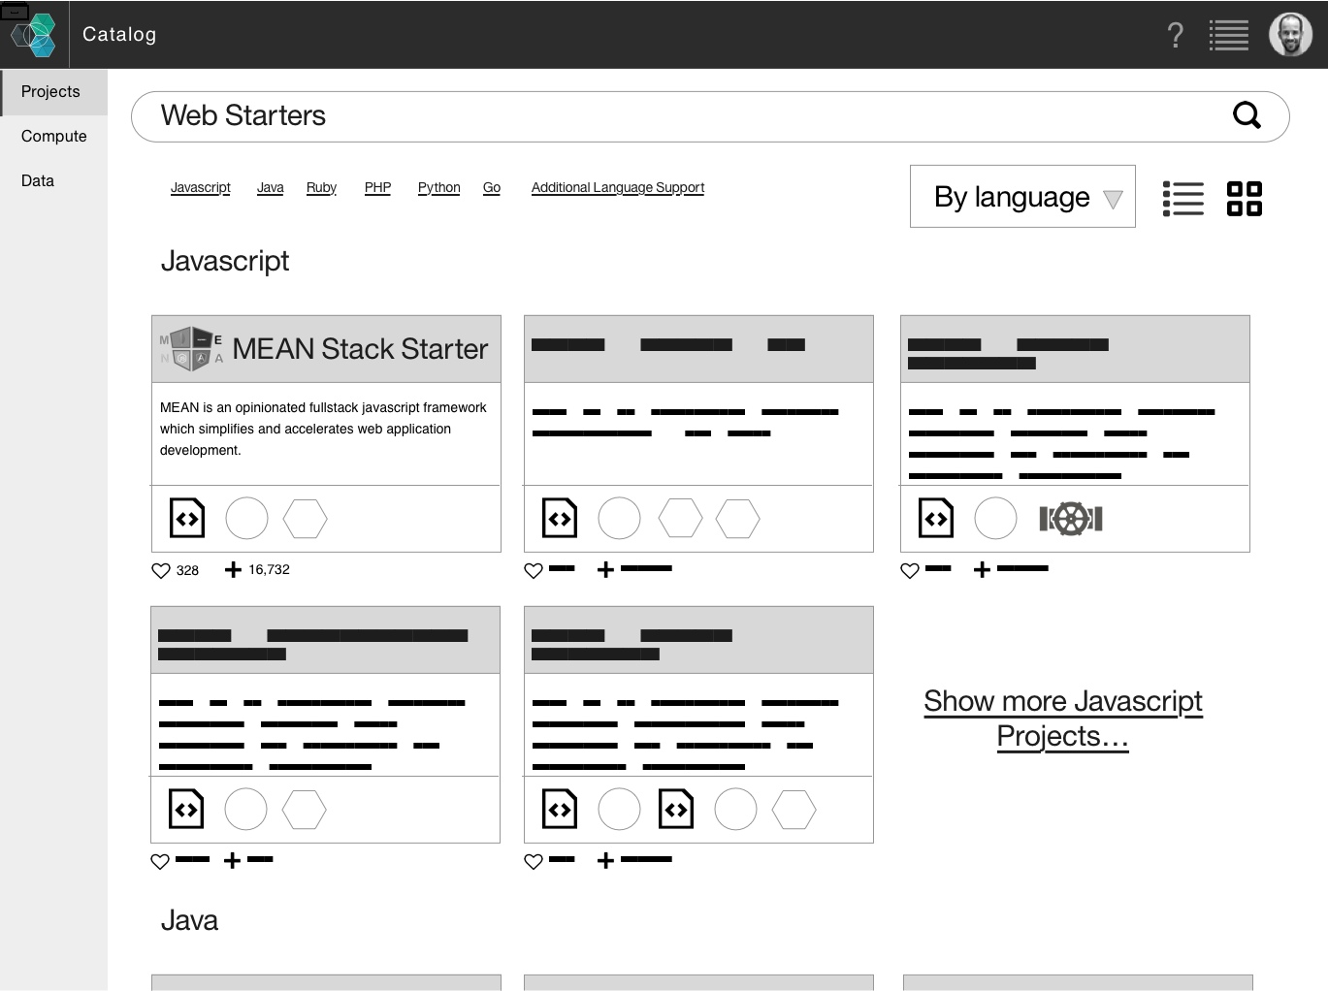
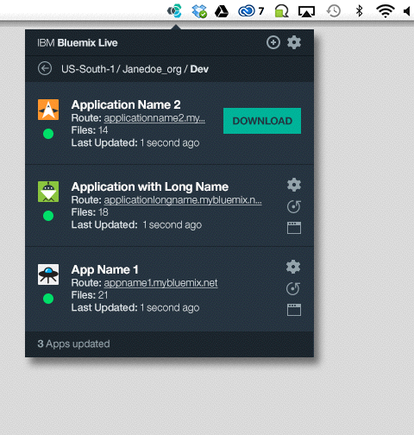
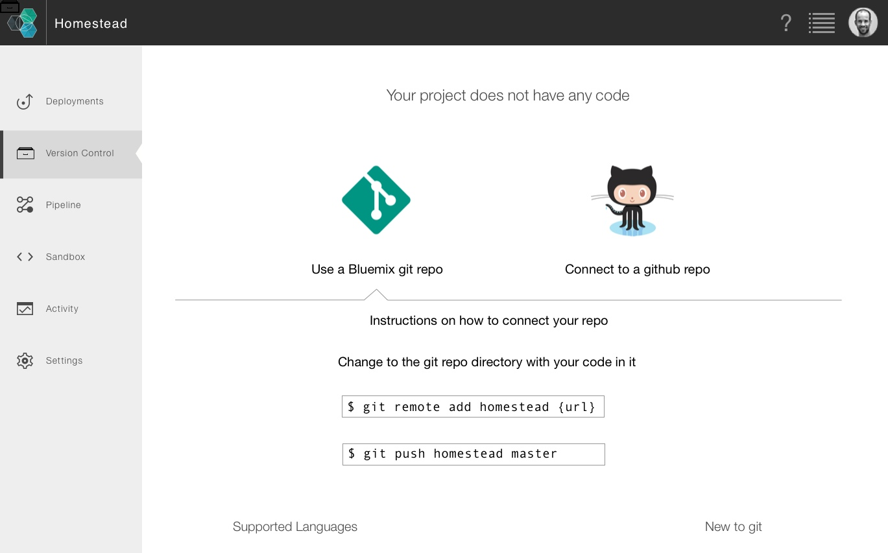

3 | Unified DevOps experience
Carlos/Raj
roadmap
The DevOps experience is unified and open across compute technologies, Bluemix delivery methods, and integrated systems.
Developer Experience
Mobile
Improved native iOS experience
Mobile First GA
Backend
Bluemix synchronization client automatically syncs local code changes with Bluemix - enabled for more languages
“Deploy to Bluemix” easy app deployment button
Single CLI experience across all of Bluemix
.NET runtime
Teams
Redesign to provided a seamless experience across the lifecycle - even for hybrid apps
Pipeline support for multiple hybrid environments (Public, Dedicated, Local, Other Clouds)
Free sandbox environment for development
Project based on-boarding of team members and collaboration features
Activity and awareness notifications
Open architecture with support for the most common tools (Jenkins, Grunt, Ant, Github….)
App analytics, improved tracing and logging
Notes:
For Mobile Developers
Improved native iOS Experience
Samples
iOS SDKs
Simplified getting started
Xcode starter project
iOS App and key management for app backends
App creation workflow
For Backend Developers
Program in the language you want with expanded language support
Eliminate the need debug apps and deploy services on development clients via Synchronization client
“Run on Bluemix” easy runtime & app deployment
Simplify making mobile ready REST services
Team
Redesigned to provide a seamless experience across the lifecycle
Improved environment pipeline
Activity awareness & notifications
Improved on-boarding of team members
Simplified project/app security and scm services across multiple runtimes
Common activity steam awareness & notifications
Builds
Promotions
Adding new services
App Analytics
Improved tracing and logging
More Info
Language Support
Today Bluemix supports Java, Node.ja, Ruby, iOS/Android. Our goal is to also provide support for Python, PHP and Go. We already have the ability to allow you to bring your own buildpacktoday and deploy these runtimes on Bluemix. The intend is to also provide validated Buildpacks for these languages and getting started documentation and samples.
BluemixLive/Synch automatically synchronizes client changes
•Today DevOps has a separate loging and site. The goal is to have this be redesigned to provide a seamless experience across the lifecycle devtest and production.
Pipeline Improvements
•Ability to define pipeline stages, flow and addon services that are triggered. Like AppScan etc.

Slide 22















App development is about speed and choice
Developers’ expectations have evolved.
Useful APIs
Seconds to
Deploy
Friction Free
Continuous Delivery Pipeline
Choice of Tools
Failing
Fast
?
Any Language
Focus on Code
Mobile Ready
Notes:
The instant power and speed of cloud has brought about new expectations for building applications on it.
Developers now expect:
To be able to deploy updates to their applications in seconds
To write their code in whichever tool or language they choose
Each has its own distinct “personality” and followings of developers have evolved around each of these
To be able to continually integrate working copies of code into a shared mainline at multiple points during the day
To focus on writing code, not on the administration of servers, virtualization, operating systems, and middleware.
To “fail fast” - or ensure applications fail immediately and visibly to speed debugging and fixes
To integrate useful APIs into their applications - who wants to write code that’s already been written and tested?
To build applications that are mobile ready - as users today expect their experience to be tailored to whatever device they happen to be using.

